Slide 1

Predict the Average Temperature
Reenie Christudass

Slide 2

Introduction
Accurate temperature forecasting is critical to many industries, from agriculture to energy production. ARIMA model is based on historical temperature data to predict the average temperature for the next three years in a specific geographic region. By incorporating seasonal trends and long-term patterns, the model produces reliable temperature forecasts that can inform decision-making and resource allocation.

Slide 3

Weather Data Requirements
Historical temperature data from the weather station
Time Series data for weather variables
Data on relevant external factors
Information about significant events
Data on seasonal trends

Slide 4
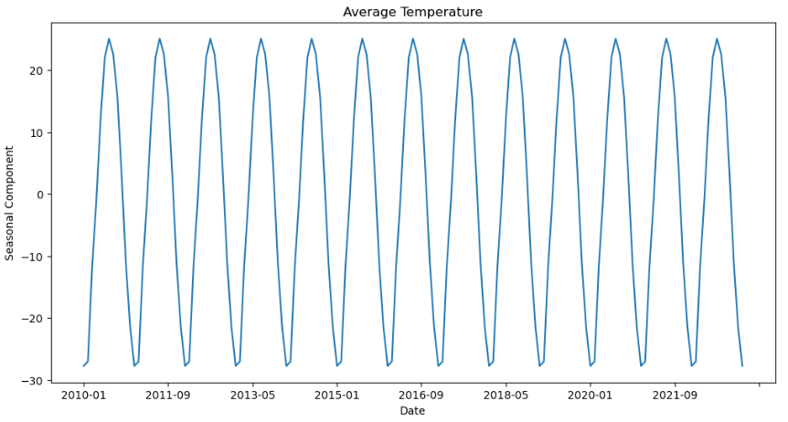
EDA - Temperature
The data spans from 2010 to present
The average temperature shows clear seasonality, with higher temperatures in the summer months and lower temperatures in the winter months
There is an overall increasing trend in the average temperature over time, although there are some fluctuations and variations from year to year
The seasonal decomposition plot shows that the seasonal component of the average temperature data is quite strong, indicating that seasonality is an important factor to consider in modeling and analyzing the data
The residual plot from the decomposition shows some variability and randomness, indicating that there may still be some unexplained factors affecting the average temperature beyond the trend and seasonal components

Slide 5
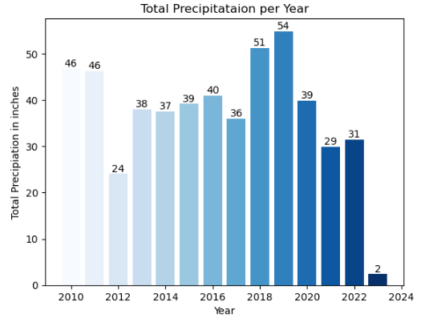
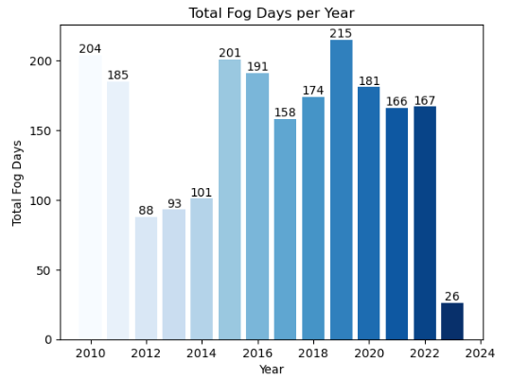
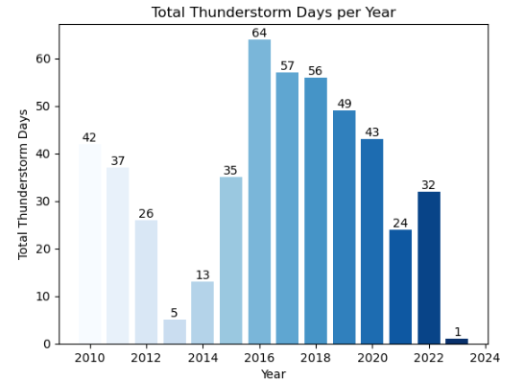
EDA – Thunderstorm, Fog, Precipitation

Slide 6
Data Cleaning
Converted the 'DATE' column to datetime format and set it as the index of the DataFrame.
Dropped the 'STATION' column as it contained only one value throughout the dataset.
Checked for and handled any missing or null values in the data by either filling them with a suitable value or dropping the corresponding rows/columns.
Checked for and handled any outliers or extreme values in the data by either dropping them or replacing them with a more suitable value.
Verified that the data followed a stationary time series by performing the Augmented Dickey-Fuller (ADF) test.
If the data was not stationary, performed differencing to make it stationary before modeling.
Checked for and handled any seasonality in the data by performing seasonal differencing or decomposition, if required.

Slide 7
ARIMA MODEL
ARIMA is a time series forecasting method that can predict future values based on historical data.
The acronym stands for Autoregressive Integrated Moving Average.
ARIMA models have three components: autoregression (AR), differencing (I), and moving average (MA).
ARIMA models are often used when there is evidence of non-stationarity in the time series data.
Determine the order of differencing (d) to make the time series stationary.
identify the appropriate values for the autoregression (p) and moving average (q) parameters using methods such as auto-ARIMA or visual inspection of ACF/PACF plots.
Once the parameters have been identified, we can use the ARIMA model to the data to make predictions.
ARIMA models have limitations and assumptions, and their accuracy can be affected by changes in the underlying data-generating process.
ARIMA models are commonly used in economics, finance, and meteorology for forecasting purposes.

Slide 8
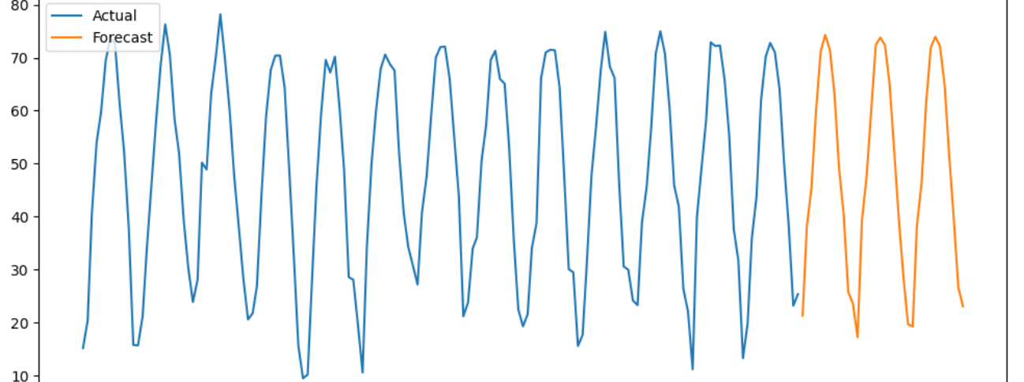
Model Metrics
ARIMA model evaluation performed without exogenous variables
AIC on training data: 819.697
RMSE: 17.09
Model evaluation with exogenous variables (AWND, PRCP, DYTS, DYFG)
AIC on training data: 819.697
RMSE: 17.09

Slide 9
Challenges, Limitations and Ethical Assessment
The ARIMA model is limited to only one weather station within Iowa, which may affect its accuracy for other stations or groups.
Exogenous variables may not be significant predictors of the dependent variable, and re-evaluation of variable selection is necessary.
The model's fairness and bias are in question as it targets only one weather station in Dubuque, Iowa, and may not be accurate for other groups or stations.
Privacy and confidentiality concerns should be addressed to ensure data protection and prevent unauthorized access to the data.
Stakeholder engagement is crucial in developing and implementing the model to align with community needs and priorities, including feedback from community members, local government officials, and emergency responders.

Slide 10

Conclusion
The ARIMA model was developed and evaluated to forecast the monthly average temperature in Dubuque, Iowa.
The model is limited to only one weather station within Iowa and may not be accurate for other stations or groups.

Slide 11

References
https://otexts.com/fpp2/
https://www.wiley.com/en-us/Time+Series+Analysis%3A+Forecasting+and+Control%2C+5th+Edition-p-9781118675021
https://www.crcpress.com/The-Analysis-of-Time-Series-An-Introduction-7th-Edition/Chatfield/p/book/9781138713548
https://www.springer.com/gp/book/9783540401723
https://www.springer.com/gp/book/9783319298528
https://www.dbpia.co.kr/journal/articleDetail?nodeId=NODE09820894&language=en
https://ascelibrary.org/doi/abs/10.1061/JTEPBS.0000336
https://www.sciencedirect.com/science/article/abs/pii/S0959652620352518
https://www.sciencedirect.com/science/article/pii/S096014811931335X
https://link.springer.com/article/10.1007/s11356-019-05319-2
https://www.mdpi.com/2073-4441/10/9/1237

